Slide 1
IBM Assignment-1 VISUALIZING THE DATA-SET
GOWTHAM S
510919104014
BE-COMPUTER SCIENCE
GLOBAL INSTITUTE OF ENGINEERING AND TECHNOLOGY.

Slide 2
Ibm Cognos Analytics with Watson
R&D Spend by state.
R&D spend colored by state sized by marketing spend.
State by R&D spend colored by marketing spend.
Marketing spend by R&D colored by R&D spend.
Profit by R&D spend colored by R&D spend.
R&D spend, profit, R&D spend
summary

Slide 3
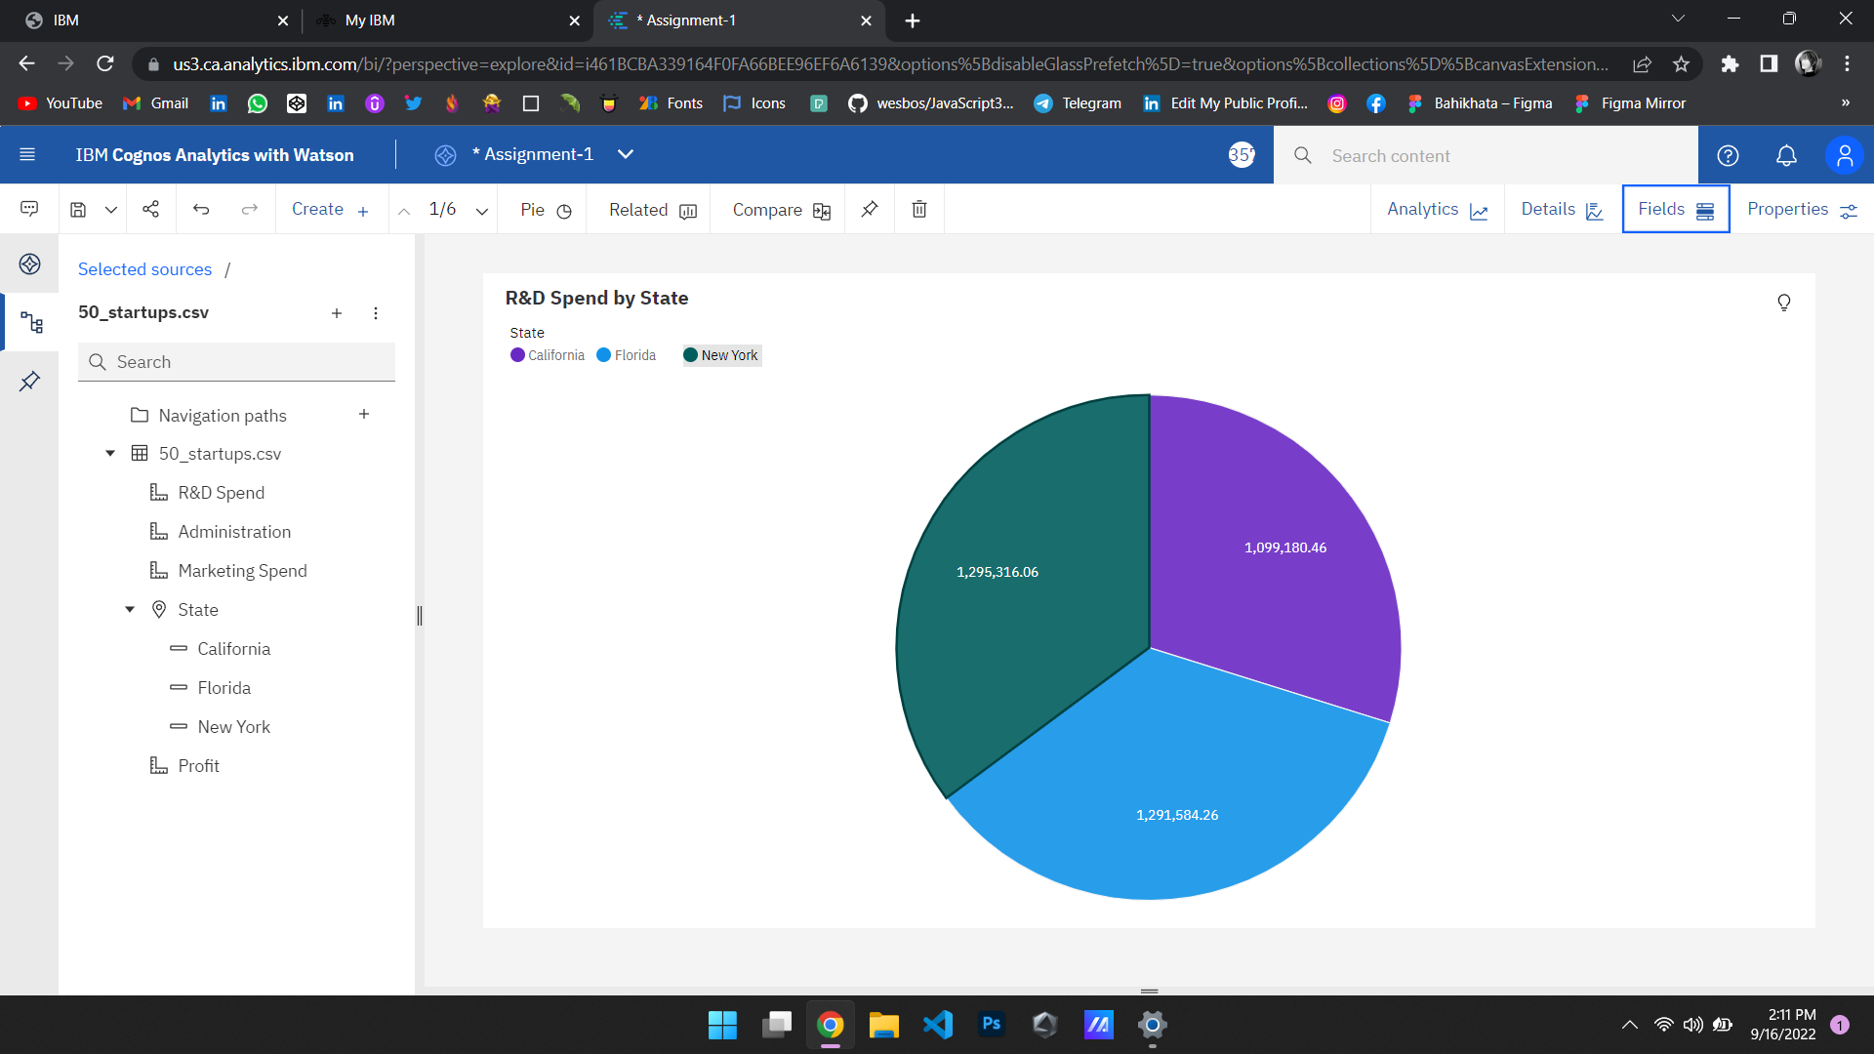
R&D Spend by state

Slide 4
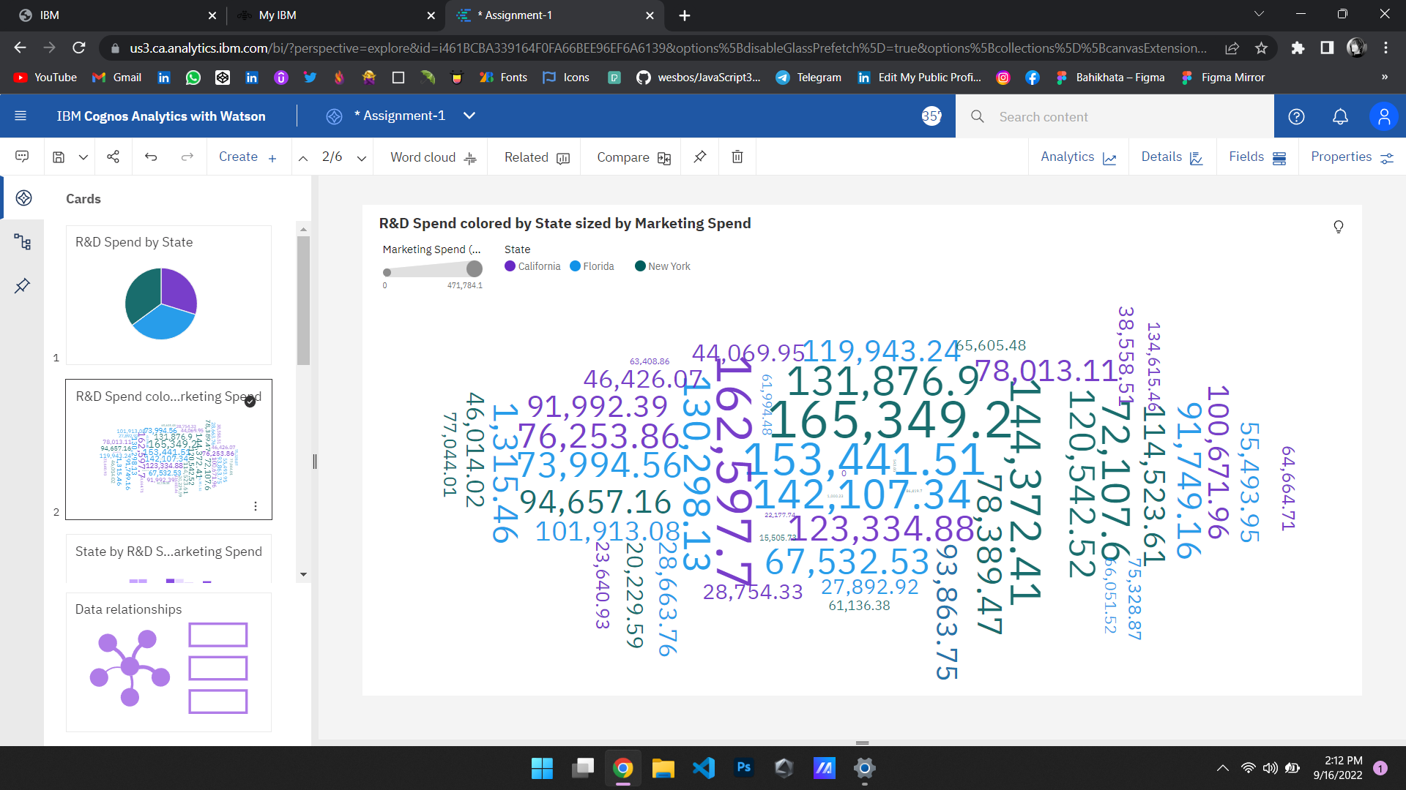
R&d spend colored by state sized by marketing spend

Slide 5
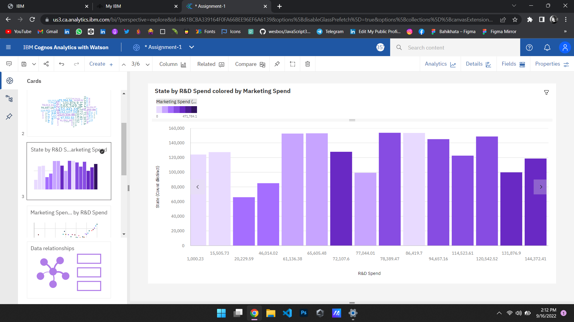
State by r&d spend colored by marketing spend

Slide 6
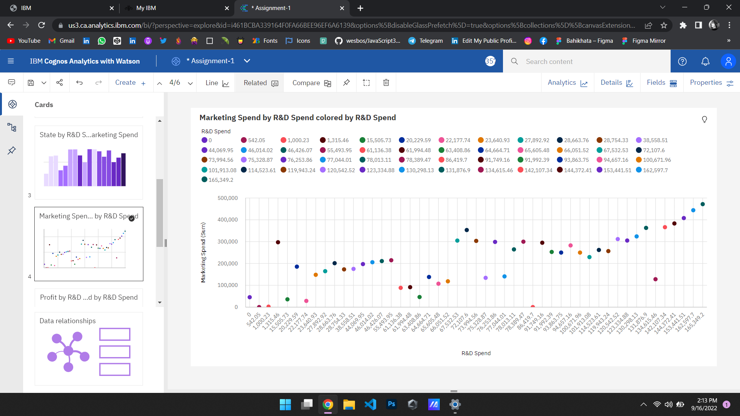
Marketing spend by r&d colored by R&d spend

Slide 7
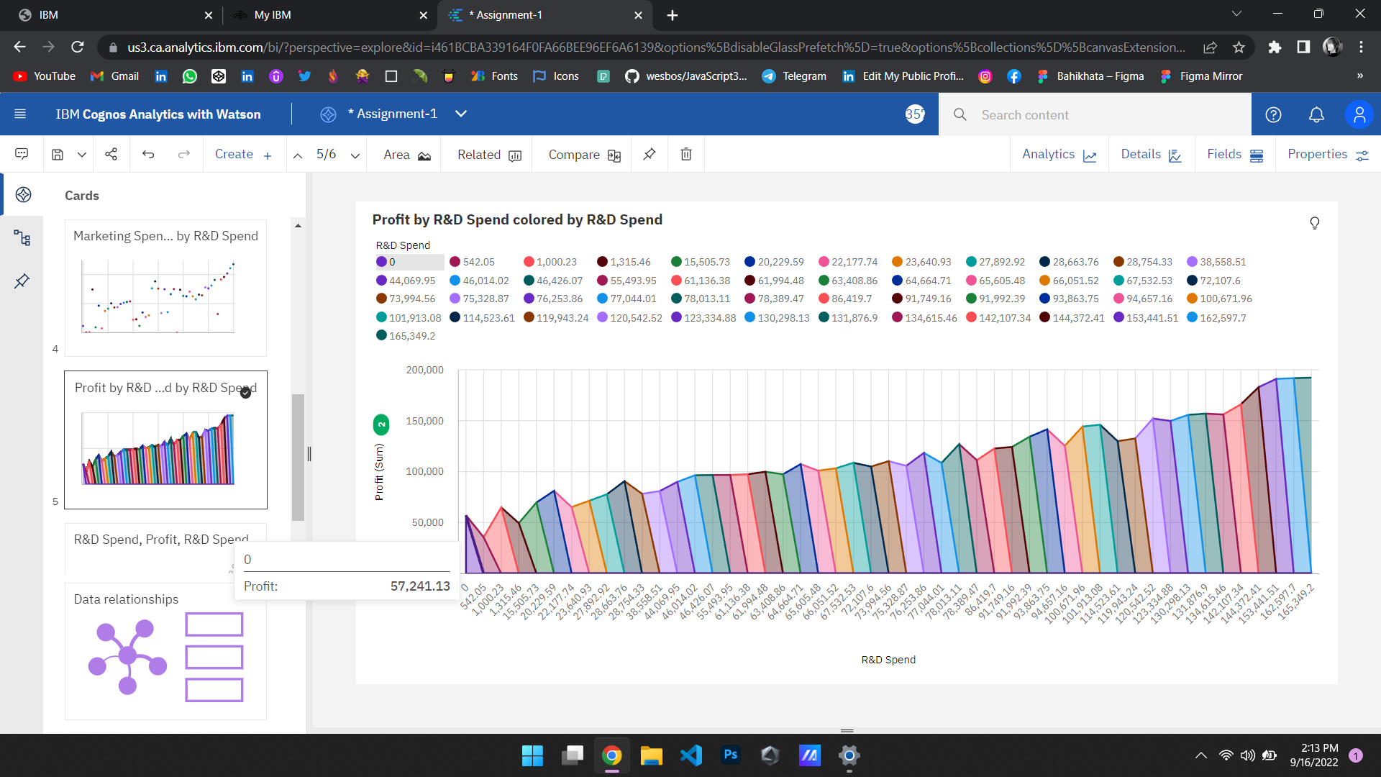
Profit by r&d spend colored by r&d spend

Slide 8
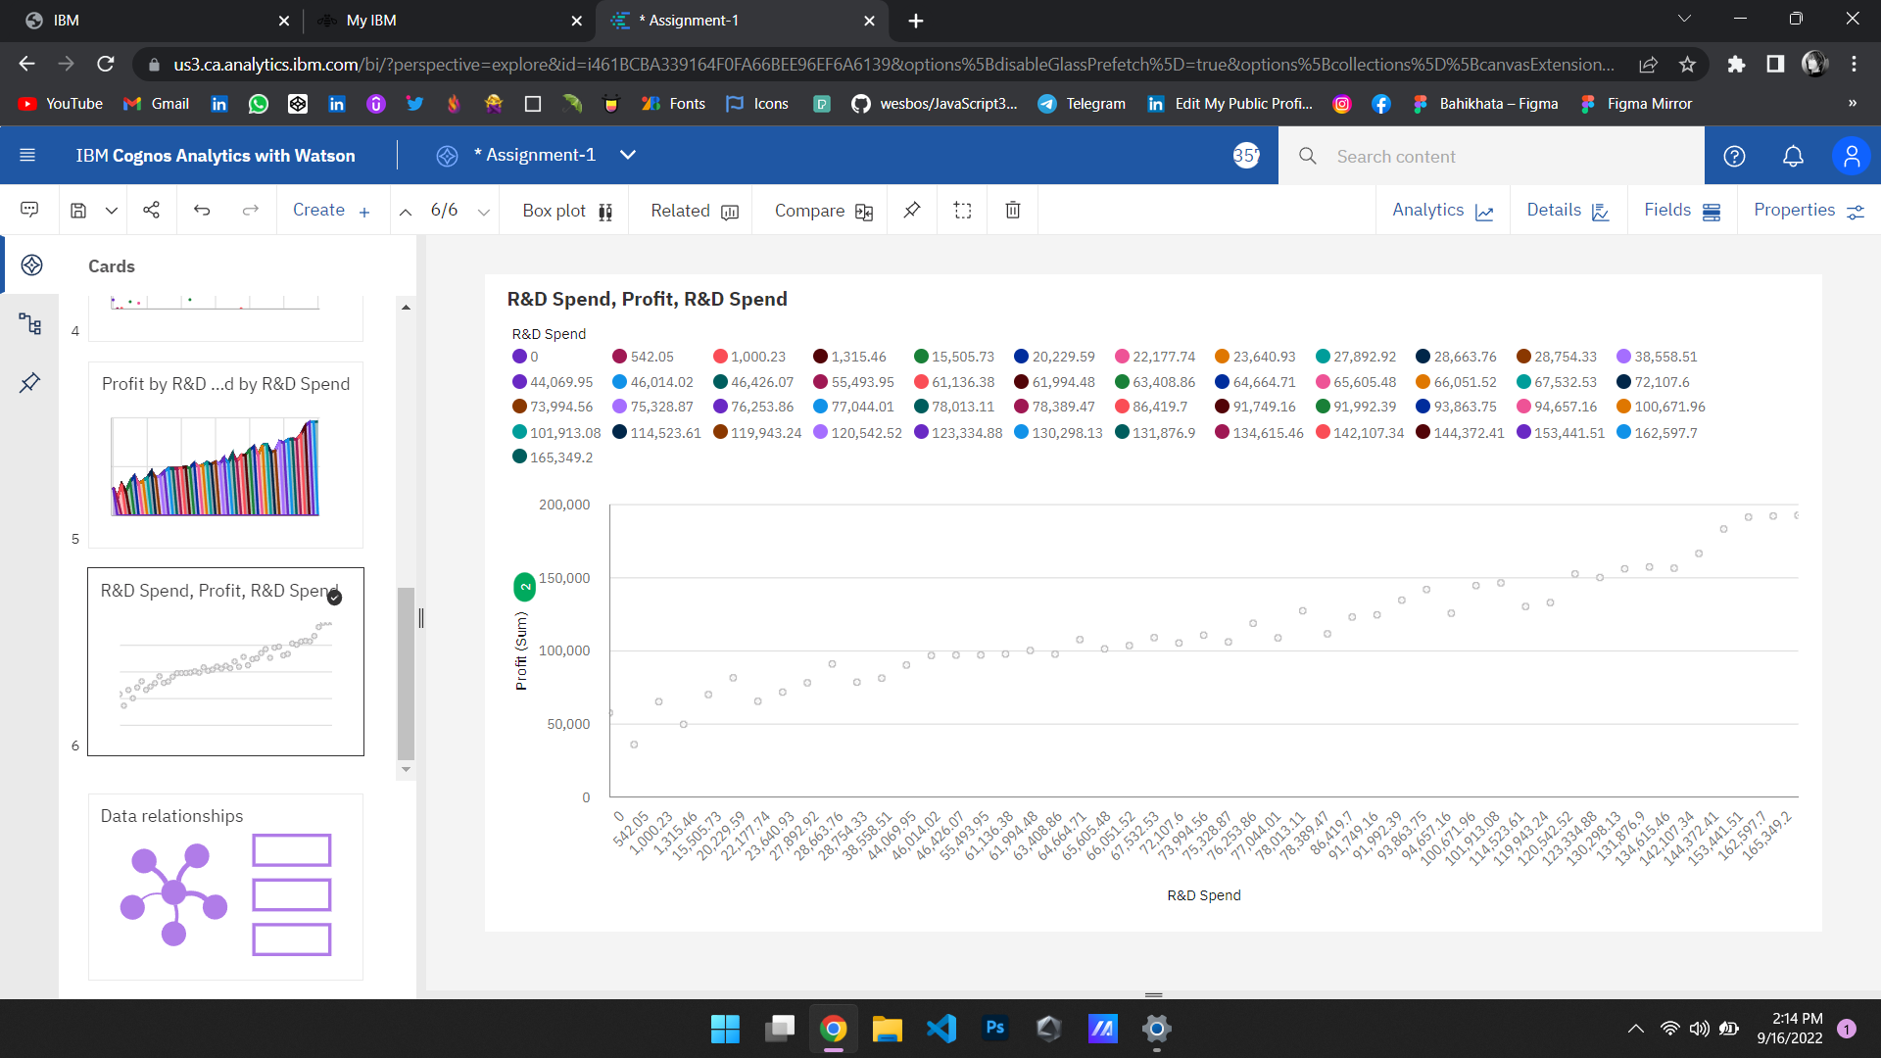
R&d spend, profit, r&d spend

Slide 9
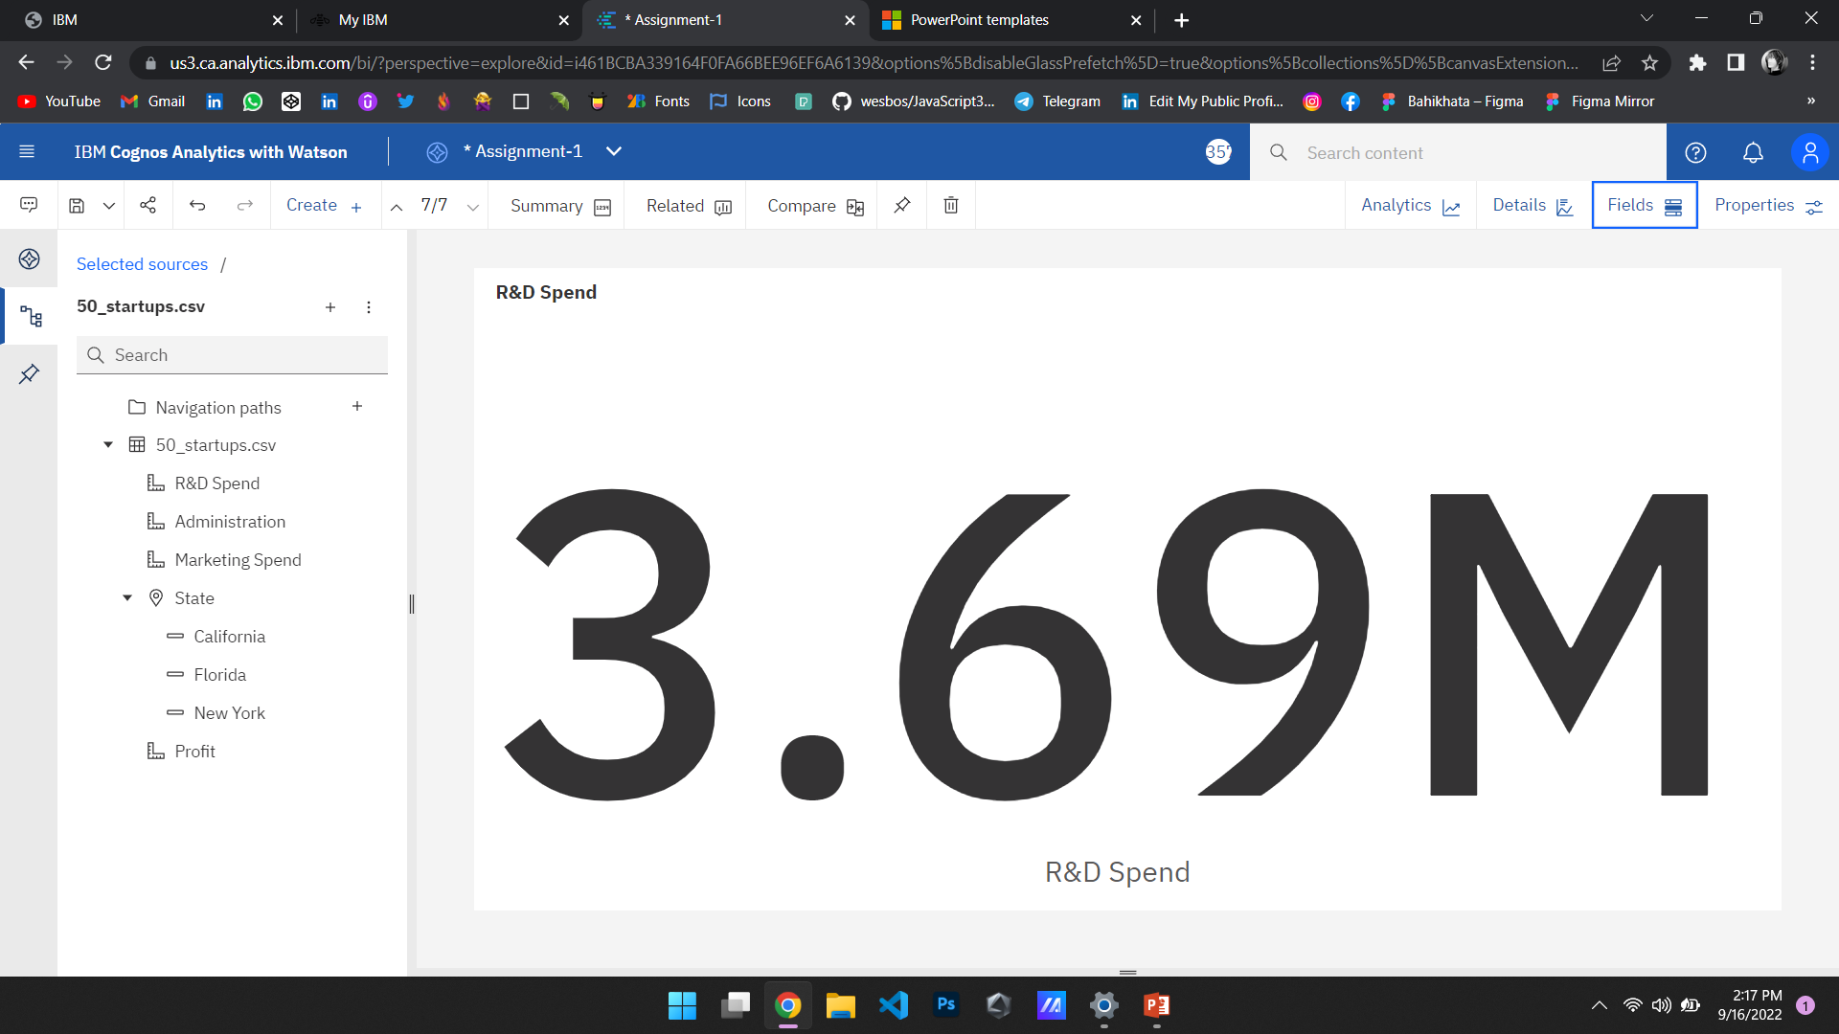
summary

Slide 10
LINK TO OPEN MY DATA VISUALIZATION IN THE COGNOS ANALYTICS.
https://us3.ca.analytics.ibm.com/bi/?perspective=explore&pathRef=.my_folders%2FData%2BExploration%2FAssignment-1&subView=model000001834565ecf6_00000004

